Slide 1

Super Store Orders Data Analysis
Presented by:
Amr Ibrahim
Emad Mohsen
Supervised by:
Eng. Ahmed Radwan
Track:
Data Analysis specialist
Presentation date:
20/10/2024

Slide 2
Project Index
Introduction
Problem Statement
Data Source
Data Cleaning & Preprocessing
Data Visualization
Discount Prediction Model
Visualization Dashboards
Conclusion
Selection of data
Data Overview
Recommendations

Slide 3
Introduction
Problem Statement:
The retail industry faces challenges in optimizing sales performance due to varying factors. This project aims to analyze a retail sales dataset to uncover insights that can help in strategic decision-making and improving overall profitability.
Objectives and Goals:
Our main objectives were to clean and analyze the dataset, identify sales and profit trends, and build interactive dashboards to assist decision-making.

Slide 4
Data Source
The dataset used for this analysis is sourced from Kaggle, a well-known platform for data science and machine learning datasets. The dataset includes information on sales transactions, customer demographics, and product details.

Slide 5
Selecting the dataset
We chose the SuperStore Orders dataset because of its comprehensive coverage of sales, customer, and shipping data across multiple product categories and regions. This allows us to extract valuable insights related to sales performance, customer behavior, and logistical efficiency. This dataset contains rich information such as customer segments, order dates, product categories, and more, making it ideal for analytics.

Slide 6
Data Overview
Dataset Information:
Name: SuperStoreOrders
Type: CSV
Number of Rows: 51,291
Number of Columns: 21
Data Types:
Numeric (Sales, Quantity, Discount, Profit, Shipping Cost)
Categorical (Customer Segment, State, Country, Market, Region, Category, Sub-Category)
Date (Order Date, Ship Date)

Slide 7
Data Cleaning & Preprocessing
The data had no null values, outliers or duplicates. Our focus was on correcting the inconsistent values and formats.
First, we handled the negative profit values. These were treated as product returns, ensuring accurate calculations for profit and loss analysis.
Next, we addressed date formats. The order date and ship date columns had inconsistent formats (some with slashes, others with dashes). We standardized them into a single format and converted them to date types."

Slide 8
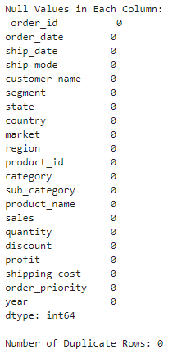
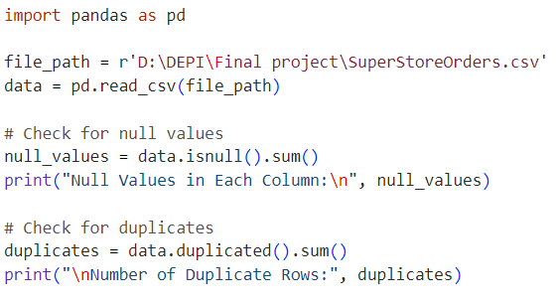
Checking for duplicates or null values

Slide 9
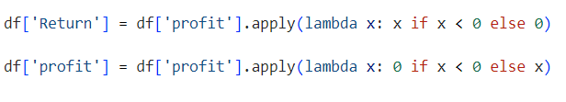
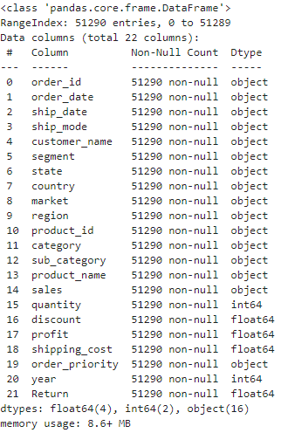
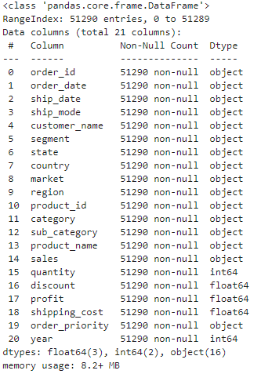
Handling negative profit values

Slide 10

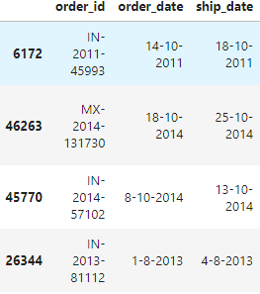
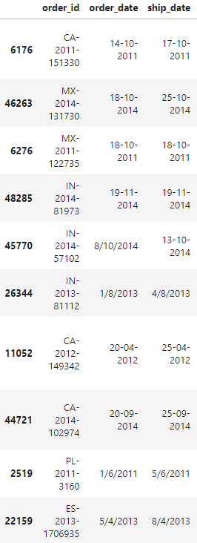
Handling Formatting inconsistencies

Slide 11
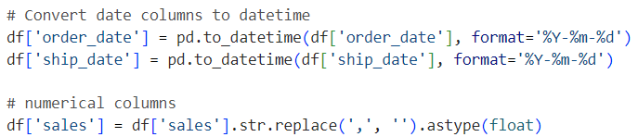
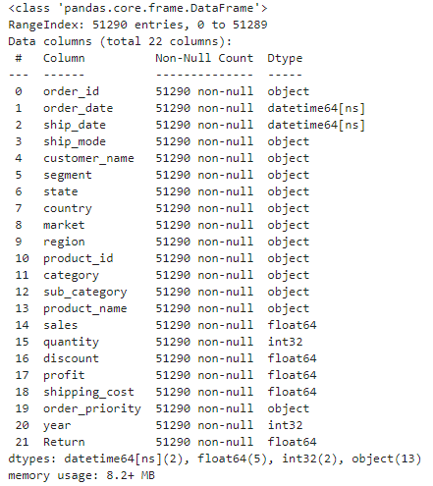
Handling Data Types

Slide 12

Data Visualization
Bar charts were created to show orders by shipping mode, segment, region, category, and sub-category. These visualizations helped identify how different customer segments and categories perform in terms of sales.
Maps were used to display geographical patterns, including the number of customers, total sales, total profit, and the number of orders by state."

Slide 13
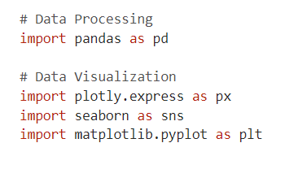
Used Libraries

Slide 14
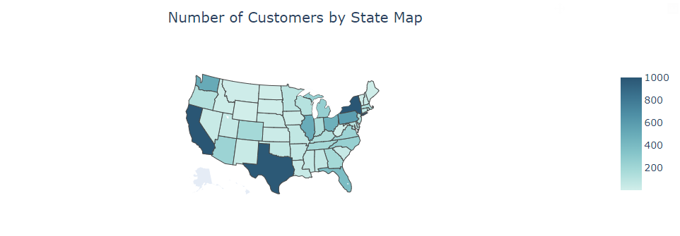
Number Of Customers By State Map
Observation:
Three most popular states among the customers are California, New York and Texas.

Slide 15
Number Of Customers By State Map
Explanation:
This is due to their large populations and economic significance.

Slide 16
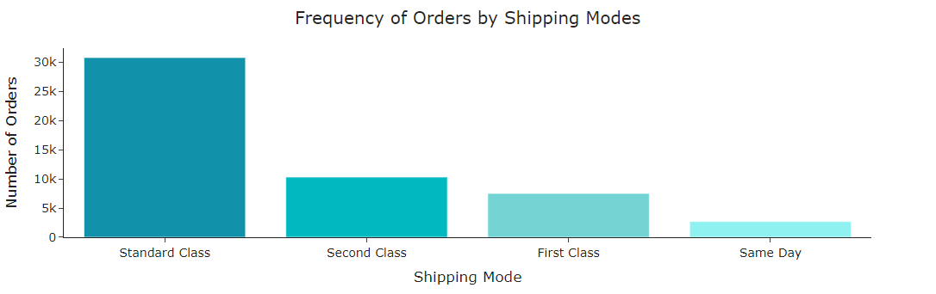
Frequency Of Orders By Shipping Mode
Observation:
This bar chart shows the distribution of orders across different shipping modes. We can observe that Standard Class is the most frequently used shipping method, followed by Second Class, while Same Day shipping has the fewest orders.

Slide 17
Frequency Of Orders By Shipping Mode
Explanation:
The preference for standard and second-class shipping may suggest that customers prioritize cost over speed.

Slide 18
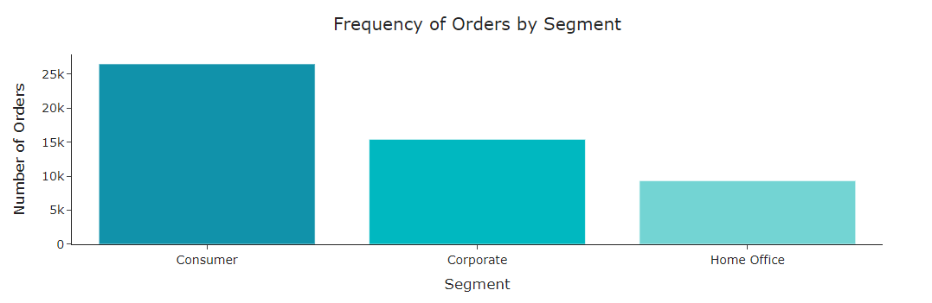
Frequency Of Orders By Segment
Observations:
The Consumer segment shows the highest order frequency
Corporate follows as the second most frequent segment
The Home Office segment has a relatively lower frequency

Slide 19
Frequency Of Orders By Segment
Explanation:
The Consumer segment shows the highest order frequency due to the fact they are the majority of customers, their immediate needs and repeated purchases. The Corporate segment follows, driven by bulk orders for ongoing business operations, though slightly less frequent due to budgeting processes.

Slide 20
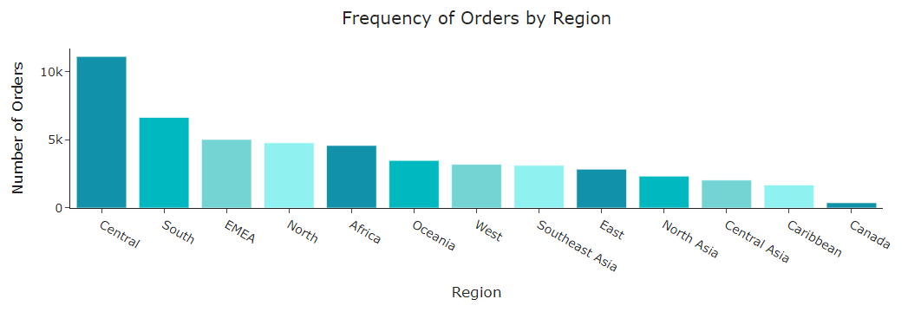
Frequency Of Orders By Region
Observation:
The order distribution analysis shows that the Central and South regions has the highest order volume

Slide 21
Frequency Of Orders By Region
Explanation:
This may reflect a stronger market presence and higher population density in the Central and South regions.

Slide 22
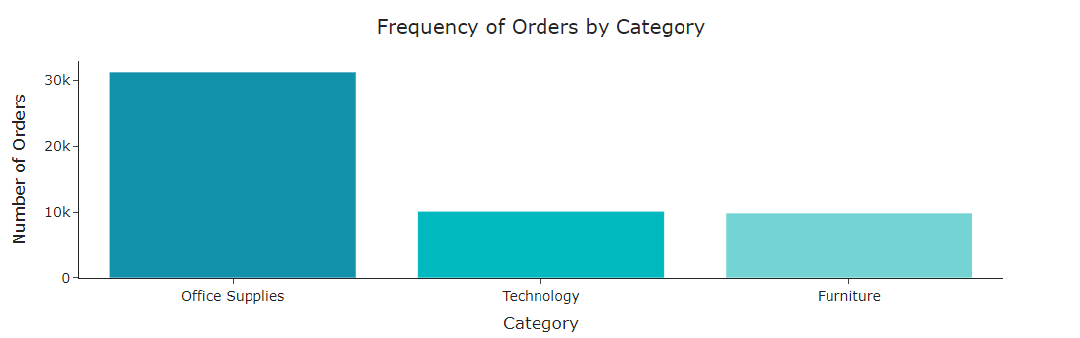
Observation:
This chart shows the distribution of orders across different product categories. Office Supplies lead in the number of orders, followed by Technology and Furniture.
Frequency Of Orders By Category

Slide 23
Explanation:
The overall trend highlights a higher priority for everyday business supplies over larger or less frequently replaced items like furniture.
Frequency Of Orders By Category

Slide 24
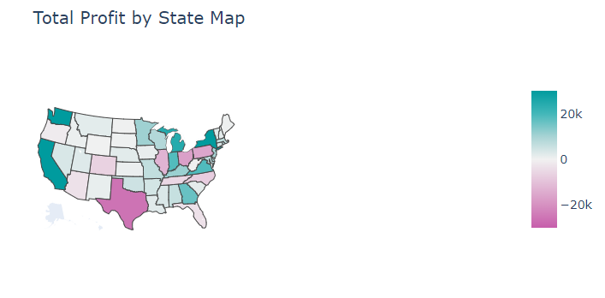
Total Profit By State Map
Observation:
Profit distribution follows a similar trend to sales, with California and New York leading. However, Texas, Ohio, Pennsylvania, and Illinois
doesn’t follow the trend

Slide 25
Total Profit By State Map
Explanation:
High sales do not necessarily correlate with high profit margins. This may be due to higher operating costs or discounts.

Slide 26
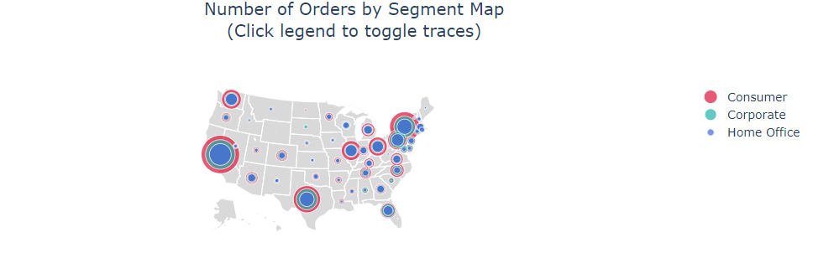
Observation:
This map visualization shows the number of orders distributed by segment across different states in the US. We see that Consumer is the largest segment, especially in states like California and Texas, followed by Corporate. The Home Office segment is much smaller in comparison.
Number of orders By segment Map

Slide 27
Explanation:
The Consumer segment shows the highest order frequency due to the fact they are the majority of customers, their immediate needs and repeated purchases. The Corporate segment follows, driven by bulk orders for ongoing business operations, though slightly less frequent due to budgeting processes.
Number of orders By segment Map

Slide 28
Discount Prediction Model
"We utilized a powerful gradient-boosting algorithm, to create a predictive model for discount forecasting."
"First, we cleaned the data by dropping irrelevant columns, including the order_date, product_name, and discount columns, among others."
"We split the dataset into training and testing sets using an 80-20 split.
"The preprocessing included scaling numerical columns using StandardScaler and one-hot encoding categorical variables to make them suitable for machine learning algorithms."
"Hyperparameter tuning was conducted using GridSearchCV, optimizing the number of estimators, learning rate, and maximum tree depth to get the best model performance."
"The model’s performance was evaluated using Mean Squared Error and R² scores, and it was highly accurate in predicting the discount."

Slide 29
Model Evaluation Conclusion
The RMSE of 0.00177 is extremely low, suggesting that the model's predictions are highly accurate, with minimal deviation from the actual values of the "discount" variable.
The R² Score of 0.9611 means that the model explains 96.1% of the variance in the "discount" values. This indicates that the model captures almost all of the underlying patterns in the data.
The mean value of y_train is 0.14296, which further emphasizes how small the error (RMSE) is in comparison to the target variable's scale. The average error is much smaller than the mean of the "discount," suggesting a strong predictive performance.

Slide 30
Sales and Profit Dashboard:
Tableau Dashboards
The dashboard presents key performance indicators (KPIs) such as total sales, total profit, total quantity, total discount, and total customers. It features various visualizations, including bar charts, horizontal bar charts, line charts, and pie charts to compare market performance, analyze sales and profit by product category, state, and country, and display trends over time. Additionally, it includes filters for the year and month of the order date, product categories, and global markets to allow users to customize their view of the data.

Slide 31
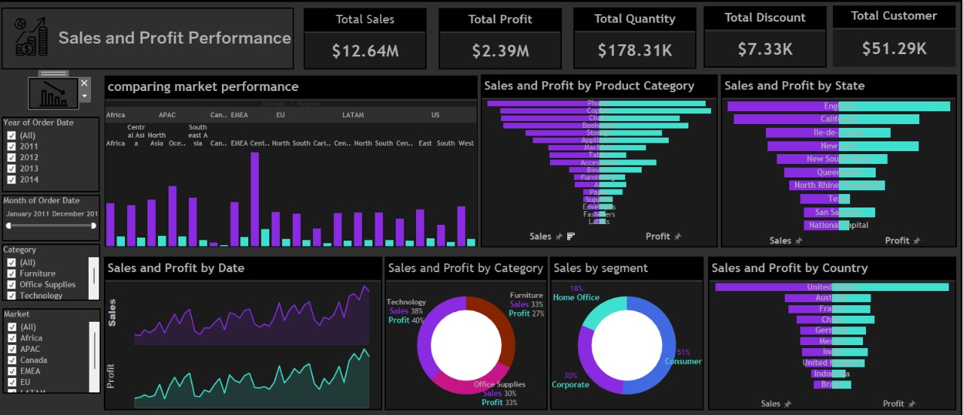

Slide 32
Tableau Dashboards
The dashboard focuses on Return and Shipping Cost Performance, presenting key performance indicators (KPIs) such as total return, return rate, total shipping cost, and discount. It includes various visualizations like bar charts, horizontal bar charts, line charts, and pie charts to compare returns and shipping costs across global markets, analyze costs by product category, state, and country, and display trends over time. Additionally, it features filters for the year and month of the order date, product categories, global markets, and shipping modes, enabling users to customize their analysis of the data.
Return and Shipping Dashboard

Slide 33
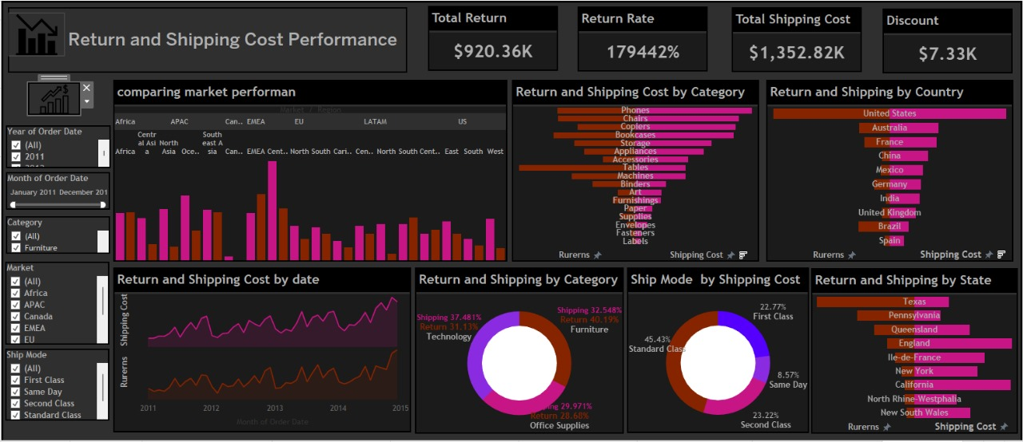

Slide 34

Recommendations
Maximize Sales in California and New York
Given these states have the highest total sales and gross profit, focus marketing efforts and customer retention strategies in these regions to further increase profitability.

Slide 35

Recommendations
Address Profit Losses in Texas, Ohio, Pennsylvania, and Illinois
Investigate the underlying reasons for significant profit losses in Texas, despite high sales. Consider reducing operating costs or improving shipping efficiency in these areas.

Slide 36

Recommendations
Re-evaluate Office Supplies Strategy
Consider introducing higher-margin products to complement Office Supplies to enhance profitability.

Slide 37
Conclusion
Through this project, we successfully cleaned and analyzed the Super Store dataset, created visualizations to extract business insights, and built a predictive model to forecast discounts.
The insights from the dashboards provide actionable information for improving sales performance, optimizing shipping costs, and reducing returns

Slide 38

Any Questions?

Slide 39

Thank you

